Slide 1
Progress in XRCS-Survey Plant Instrumentation and Control Design for ITER
Sanjeev Varshney¹, Shivakant Jha¹, Stefan Simrock²,
Robin Barnsley², Vincent Martin², Sapna Mishra¹,
Shreyas Patel¹, Vinay Kumar¹
¹ ITER-India, Institute for Plasma Research, A29, GIDC Sector 25, Gandhinagar – 380016 India
² ITER-Organization, Route de Vinon sur Verdon, CS 90 046, 13067 St. Paul-Lez-Durance, France
22nd April 2015
sanjeev@iter-india.org

Slide 2
Outline
Introduction
Overview of XRCS-Survey spectrometer
Operation Roles and Requirements
XRCS-Survey’s Plant I&C
- Architecture and hardware configuration
- Plant functions
- Interface with CODAC
- Cubicle configuration
- etc.
Summary

Slide 3
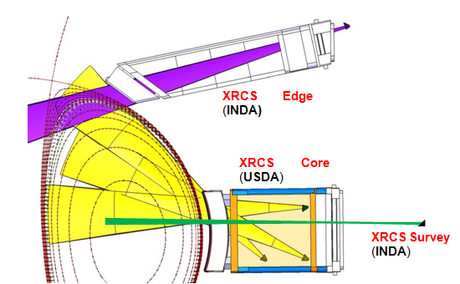
Introduction: XRCS Package
ITER-India has signed procurement arrangements to deliver ‘two’ X-ray Crystal Spectrometers to ITER:
1) XRCS-Edge “imaging
10% of the outer plasma”
Ion temperature profile
Plasma rotation profile
2) XRCS-Survey “core
plasma emission in broad
band”
Impurity identification
- Concentration, in-flux
UP-09
EP-11

Slide 4
Operation roles and requirements
Flow-down of Measurement Requirements for the XRCS Survey system, from the Diagnostic SRD (ITER_D_28B39L – SRD-55 (Diagnostics) from DOORS).
Diagnostics Role* | Operation Role | Measure | Parameter | Range | Time Resolution | Space Resolution | Accuracy
Primary | 1a.2 BC | 12. Impurity species monitoring | Be, C, O rel. conc. | 1•10⁻⁴ - 5•10⁻² | 10 ms | Integral | 0.1
 |  |  | Cu rel. conc. | 1•10⁻⁵ - 5•10⁻³
 |  |  | Ne, Ar, Kr rel. conc. | 1•10⁻⁴ - 2•10⁻²
 |  |  | W rel. conc. | 1•10⁻⁶ - 5•10⁻⁴
Primary | 1a.1 MP | 12. Impurity species monitoring | O, Be, C influx | 1•10¹⁶ - 5•10¹⁹ /m²s | 10 ms* Limited by transport & ionisation time | Integral | 0.1
 |  |  | Ne , Ar, Kr influx | 1•10¹⁶ - 2•10¹⁹ /m²s
 |  |  | Cu influx | 1•10¹⁵ - 5•10¹⁸ /m²s
 |  |  | W influx | 1•10¹⁴ - 5•10¹⁷ /m²s
Supplementary | 1a.2 BC | 13. Z_{eff} (line averaged) | Z­_{eff} | 1.0 – 5.0 | 10 ms | Integral | 0.2

Slide 5
Overview of 55.ED XRCS-Survey
7 channels Bragg spectrometer with fixed crystals and detectors
Slot in diagnostic first wall acts as the spectrometer entrance slit
Crystals are curved in 2D (but they are not in in-plane focusing)
detector
nλ = 2d.sin(θ_{Bragg})
2x Pilatus detectors
λ₃
λ₂
λ₁
1
2
3
O
3.3 cm
R_{x} ≈ 20 cm
w_{s} ≤ 1 cm
45⁰
slit
h_{x} = 10 cm
0.1 – 10 nm X-rays
crystal
u ≈ 10 m

Slide 6
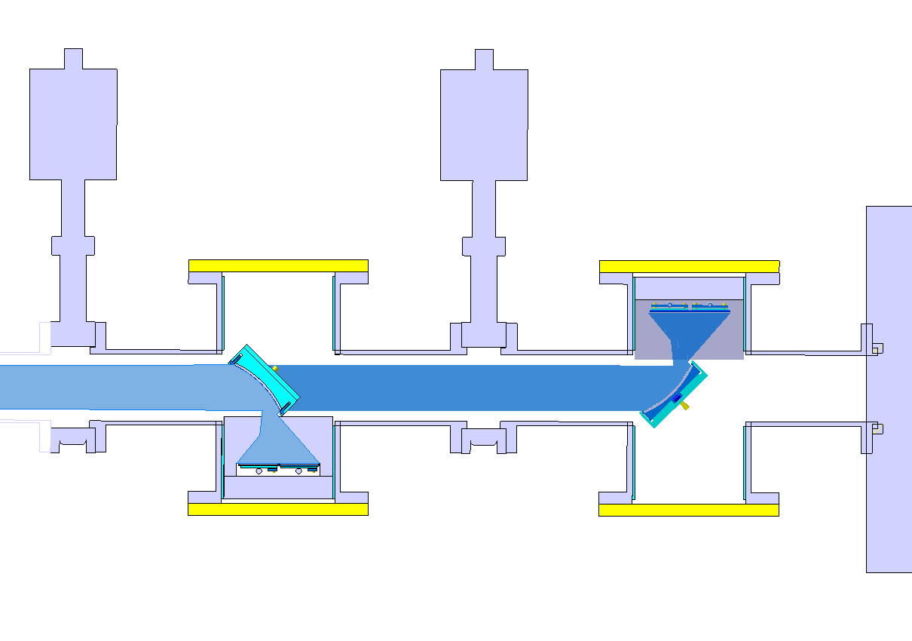
Cont..
Vacuum valve
Longer wavelength
group
Short wavelength group
X-ray detectors
X-ray detectors
Crystals & mounts
S. Varshney, R. Barnsley et al., Rev. Sci. Instrum. 83 (2012)

Slide 7
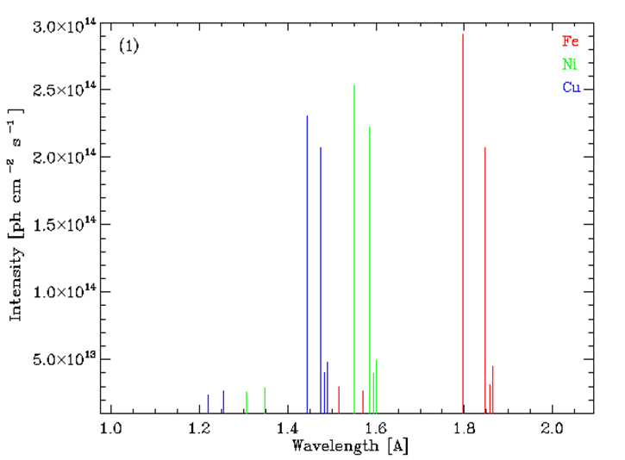
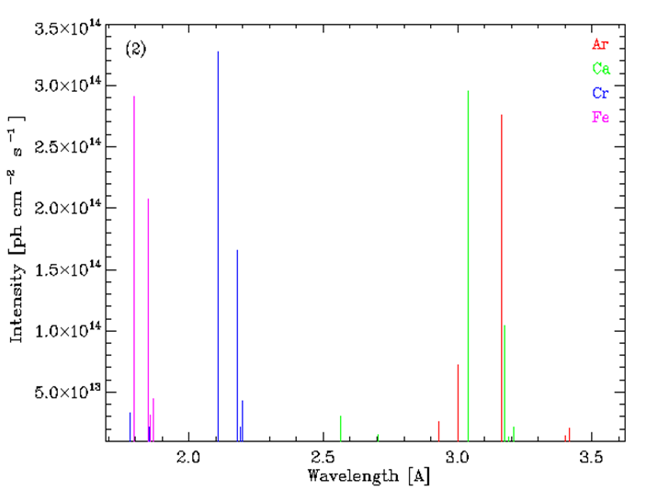
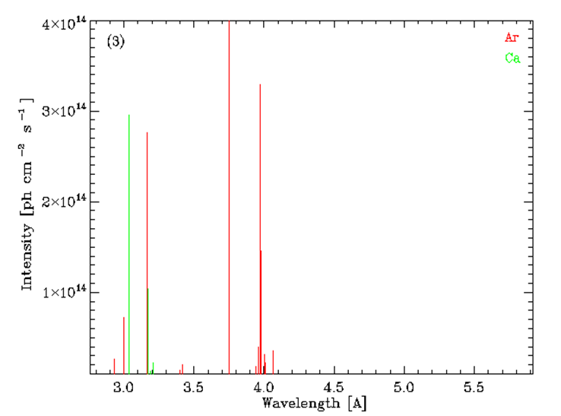
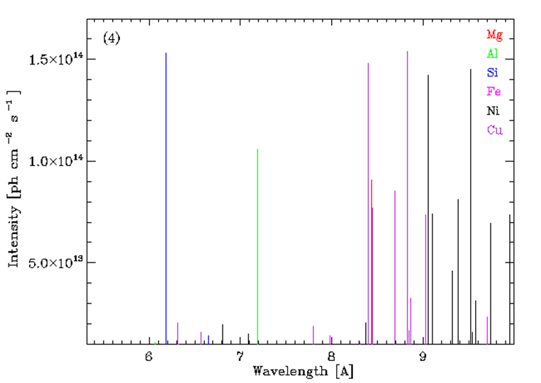
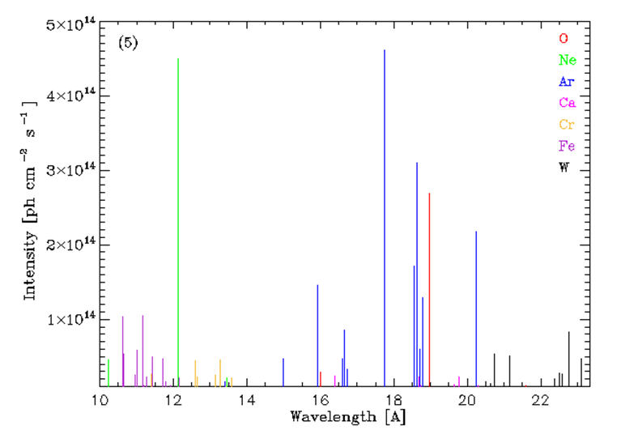
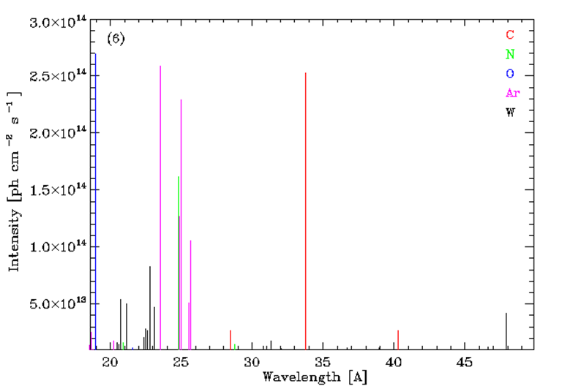
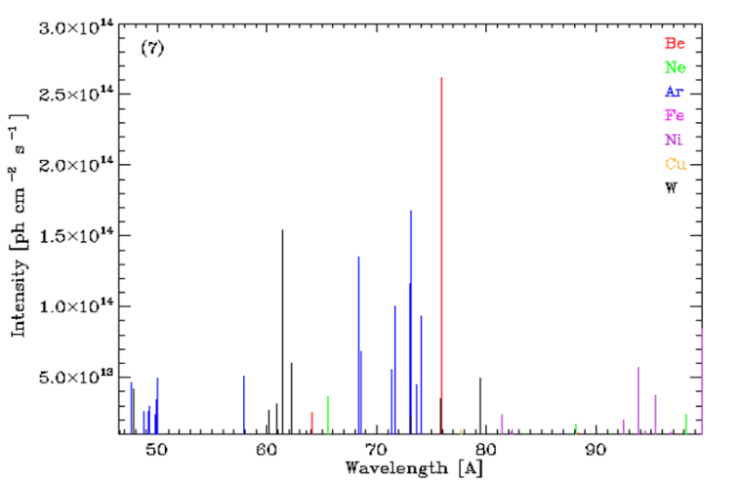
Expected impurity spectra
ADAS and SANCO impurity transport modeling (central chord) for H-mode plasmas
̶ database of ~ 5000 spectral lines from potential impurities in plasmas
̶ H- and He-like lines in 1 – 100 Å

Slide 8
XRCS Survey: a zonal view
Side view of EP 11, ISS, PCSS
Port plug zone
Interface support structure zone
Port cell support structure zone
Sight tube shielding
Vacuum Pumping line
Bio-shield
Spectrometer chamber

Slide 9
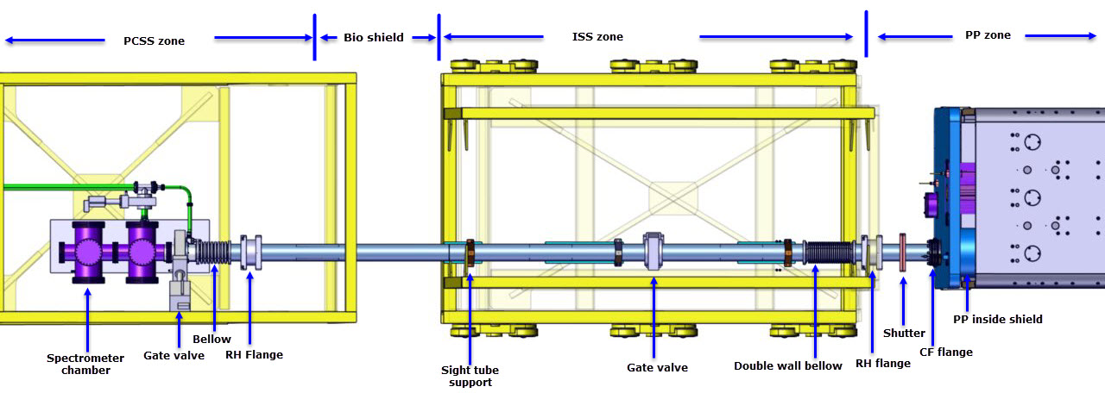
Plant functions
X-ray Image measurements: Low energy, High energy photons
from plasma and calibration sources
Calibration source operation
Vacuum pumping, monitoring, control, leak detection etc.
Heating: temperature monitor and control
Optics positioning (multi axis)
Cooling and gas feeding (CCD & HPX)
Strain in front end components
Shutter (opening/ closing)
Steady state power input
Synchronization and Communications with CODAC

Slide 10
I&C interfaced components
Sr. N | Components | QTY | Zone Location | Data Type | Description
1 | Thermocouples | 8 | ISS, PCSS | A | Temperature measurement
2 | Strain Gauges | 2 | PCSS | A | Strain measurement
3 | Gate Valves, valves | 3 + 8 | PCSS | A & B | For Vacuum control
4 | Vacuum Gauge | 4 | PCSS | A | Vacuum measurement gauges
5 | Shutter | 1 | ISS | A & B | To close sight tube
7 | Heating jackets | 1 | PCSS | A & B | Heating of sight tube
8 | TM Pump | 1 | PCSS | NA | Turbo molecular pump for vacuum
9 | Detector (CCD, HPX) | 2 | PCSS | NA | X-ray radiation detection
10 | Gas and water flow controllers | 4 | PCSS | A & B | Detector requirement
11 | Detector Server | 2 | Gallery | NA | Control & configuration of detector
12 | Hexapod | 2 | PCSS | NA | Hexapod device for crystal movement
13 | Hexapod controller | 2 | Gallery | NA | Hexapod controller for position control

Slide 11
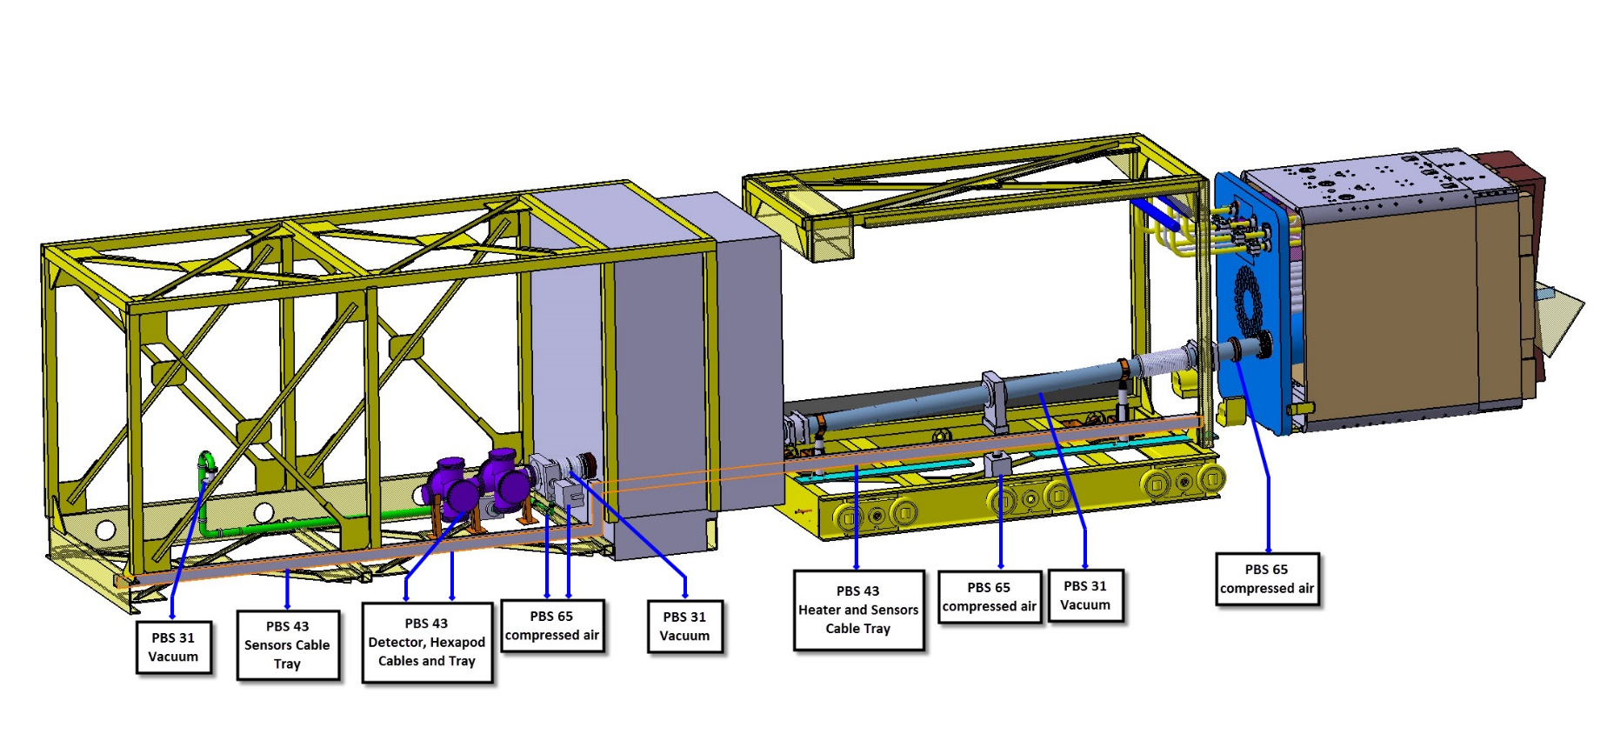
PBS Interfaces of the system
.

Slide 12
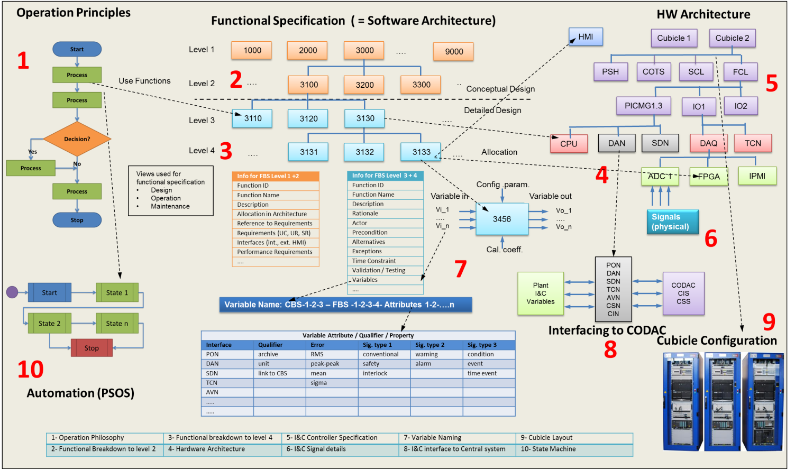
Diagnostics I&C design work flow
Stefan Simrock et. el., SOFT-2014

Slide 13
I&C PDR prerequisites
For the PDR (planned for mid 2016) following deliverables
including Technical Specifications are in-work:
D1: Plant System I&C Architecture
D2: Plant System I&C Boundary Definition
D3: Plant System I&C Integration Plan
D4: Plant System P&IDs, Mech./Electr. Diagrams
D5: Plant System Controller Perf./Config. Req.
D6: List of I/O of Plant System Controllers
D7: List of Process Variable
D8: Configuration of I&C Cubicles
D9: Description of Plant System State Machine

Slide 14
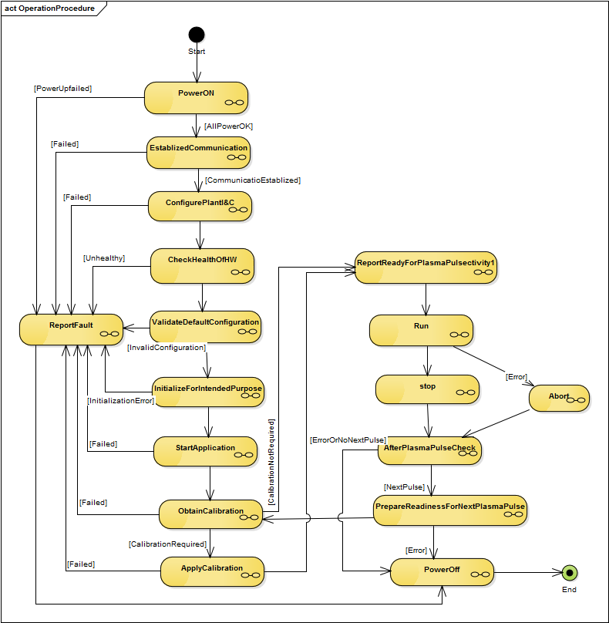
Operation procedure(s)
Read status of breaker switches for powering cubicles and auxiliary equipment of the diagnostic.
Check power status/ verify for I&C equipments.
Monitor health of chassis / boards, equipment and all components.
Verify status of all communication links (PON, SDN, DAN, TCN)
Read back configuration of plant I&C
Hardware
Cubicle
IO Boards & chassis configuration (ADC, timing card..etc)
PSH
COTS (Hexapod controllers, Detector Server, vacuum controller )
Software
High level functions (Level 1+2)
Detailed functions (level 3+4)
COTS functions
Check validity of configuration and compare to the desired configuration Note: Same Hardware and Software as under 9.
Correct configuration as needed and validate
Check integrity of all subsystems (Hardware, Software). Run system tests and generate test reports. Document issues in log book. This includes external systems (archiving, PCS).
Check calibration status and calibrate subsystems systems as needed.
Initialize plant I&C for intended purpose (using HMI, S&R, scheduling system, other scripts)
Set-up plant I&C for operation
Start services required for run

Slide 15
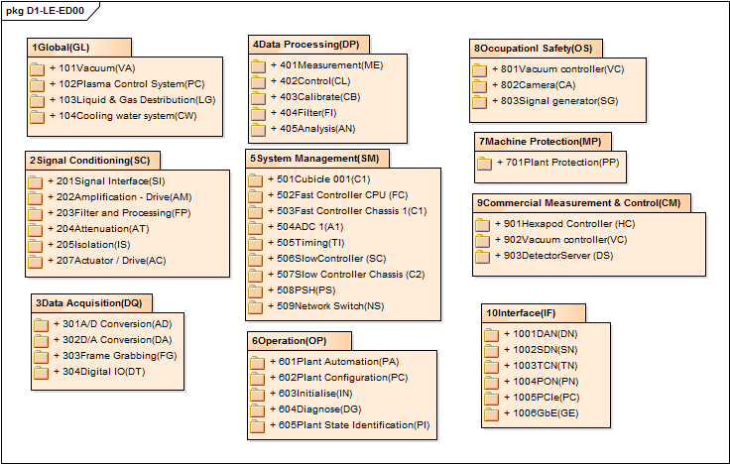
Functional Breakdown Structure
- Functional Breakdown Structure (FBS) using several functional group types.
Group types are based on Device functionality, Usage function, System management, Operation procedure, Plant I&C interface, Data acquisition, Data Processing, COTS etc.
FBS is done up to level 2 and progressing for up to level 4.

Slide 16
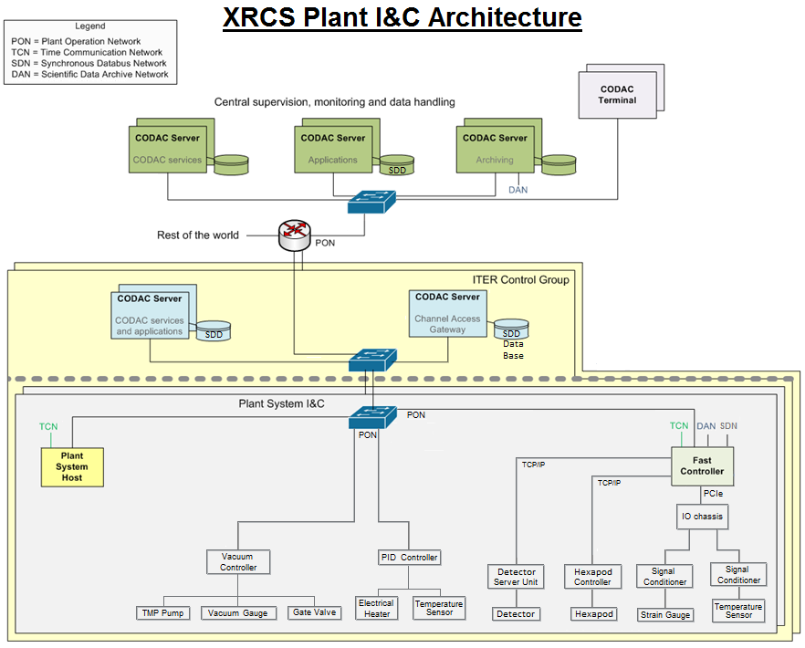
55.ED I&C architecture
2x
2x

Slide 17
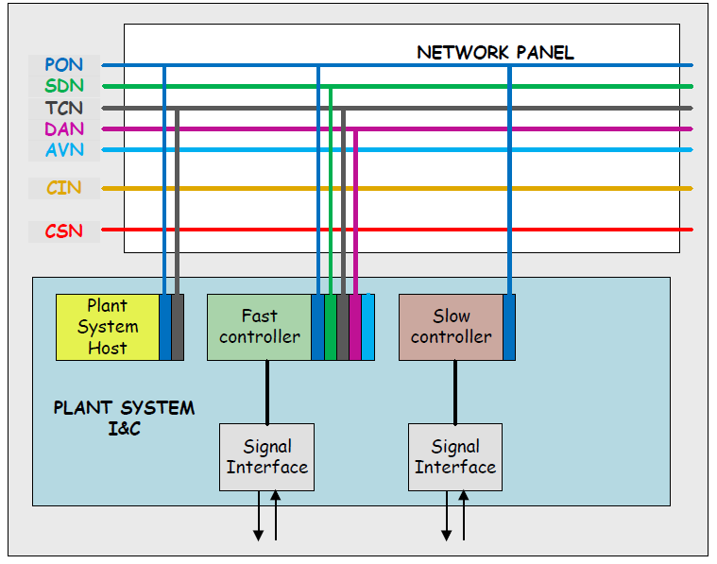
Network configuration
Sr.N. | Network | Interface requirements | Location of cubicle | Name of Controller/Device | Sampling Rate
1. | PON | Yes | 74-L1 | 55ED00-PLC-0001 | 10 Hz
 |  |  | 74-L1 | 55ED00-PFC-0001 | 100 KHz
 |  |  | 74-L1 | 55ED00-PSH-0001
2. | TCN | Yes | 74-L1 | 55ED00-PFC-0001
 |  |  |  | 55ED00-PSH-0001
3. | DAN | Yes | 74-L1 | 55ED00-PFC-0001
4. | SDN | Yes | 74-L1 | 55ED00-PFC-0001
5. | AVN | NA | - - | - -
6 | CIS | NA | - - | - -
7 | CSS | NA | - | - -

Slide 18
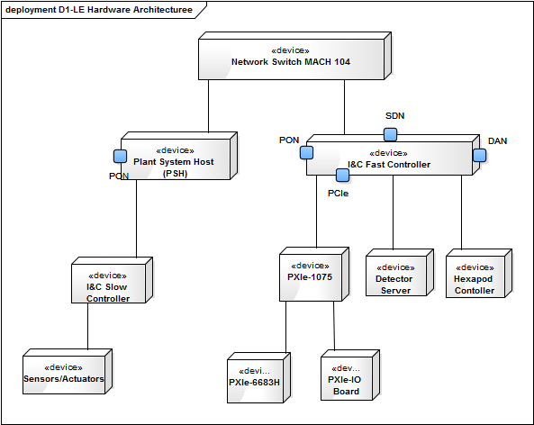
Proposed hardware definition
List of hardware with description
Hardware architecture in EA
Components | Specifications/Remarks
Network Switch | Hirschman- MACH 104-20TX-FR
Plant System Host | Industrial computer for communication between CODAC & Plant I&C
I&C Fast Controller | Industrial grade Fast controller PICMG 1.3 PCIe
IO chassis | NI IO chassis PXI-1085
PXIe- Board | IO Cards, MIXI bridge modules PXIe – PCIe 8371
TCN | NI TCN Cards-6683H
Hexapod Controller | Hexapod device controller [COTS]
Detector Server | Detector configuration & data acquisition server [COTS]

Slide 19
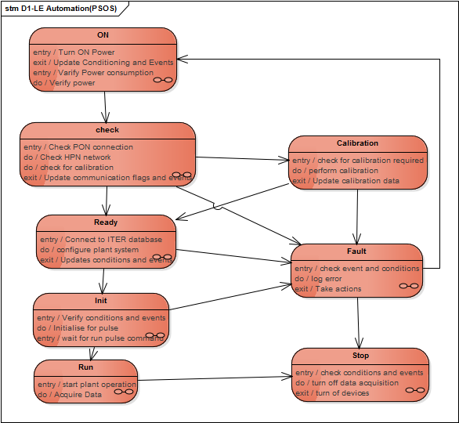
Plant automation
PSOS
Pulse {measurement}
Ready {Ready for plasma}
Vacuum {prepare system}
Calibration {System calibration}
TCS {configuration}
Standby {I&C operational}
Off
GOS
Long Term Maintenance
Short Term Maintenance
Test and Conditioning state
Plasma operating state

Slide 20
Cubicle configuration
LCC cubicle in DB 74 L1
SCC cubicle in Gallery
Cubicle health monitor
Cubicle health monitor
Network switch
Network switch
Detector server
Plant System Host
Hexapod controller
Signal interface
Fast controller
100 m
PID controller
Signal interface
Vacuum controller
IO Chassis and modules
Signal conditioning modules
Power supply
Power supply

Slide 21
Maturity assessment
The maturity of the design is assessed by the following criteria:
Coverage of each of the plant I&C design topics
Quality of items of each topic in diagram
Quality of description of the items
Quality of description
Level of PCDH compliance for the design
Tracing of items to system req.
Relationship between items
Completeness of interfaces
I&C Topic | Maturity Level (%)
OP Procedure | 40
Functional Breakdown | 40
Hardware Architecture | 30
Variable definition | 20
Cubicle configuration | 30
PSOS | 10
Current maturity assessment for XRCS-Survey
plant I&C development →

Slide 22
Summary
Detailed design of diagnostics and I&C is evolving
Enterprise Architecture hands-on in order to develop Plant I&C.
Prepared level L1 & L2 Functional breakdown & Operation procedures for global and L1, L2 functions. Its ongoing for higher levels.
Concept for hardware architecture and hardware components along with their configuration
Soon to start experimenting with Integration kit to configure Plant functions and develop XRCS-Survey Plant I&C system.

Slide 23
Thanks for your kind attention.

